Slide 1
Support Vector Machine

Slide 2
Support Vector Machine (SVM)
Support Vector Machine (SVM) is a supervised machine learning algorithm used for classification and regression tasks. It tries to find the best boundary known as hyperplane that separates different classes in the data. It is useful when you want to do binary classification like spam vs. not spam or cat vs. dog.

Slide 3
Support Vector Machine (SVM)
The main goal of SVM is to maximize the margin between the two classes. The larger the margin the better the model performs on new and unseen data.

Slide 4
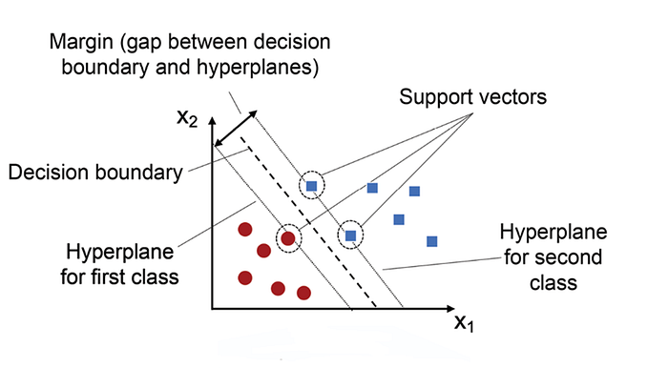
SVM

Slide 5
Key Concepts of Support Vector Machine
Hyperplane: A decision boundary separating different classes in feature space and is represented by the equation wx + b = 0 in linear classification.
Support Vectors: The closest data points to the hyperplane, crucial for determining the hyperplane and margin in SVM.
Margin: The distance between the hyperplane and the support vectors. SVM aims to maximize this margin for better classification performance.

Slide 6
Kernel: A function that maps data to a higher-dimensional space enabling SVM to handle non-linearly separable data.
Hard Margin: A maximum-margin hyperplane that perfectly separates the data without misclassifications.
Soft Margin: Allows some misclassifications by introducing slack variables, balancing margin maximization and misclassification penalties when data is not perfectly separable.
C: A regularization term balancing margin maximization and misclassification penalties. A higher C value forces stricter penalty for misclassifications.
A loss function penalizing misclassified points or margin violations and is combined with regularization in SVM.

Slide 7
How does Support Vector Machine Algorithm Work?
The key idea behind the SVM algorithm is to find the hyperplane that best separates two classes by maximizing the margin between them. This margin is the distance from the hyperplane to the nearest data points (support vectors) on each side.

Slide 8
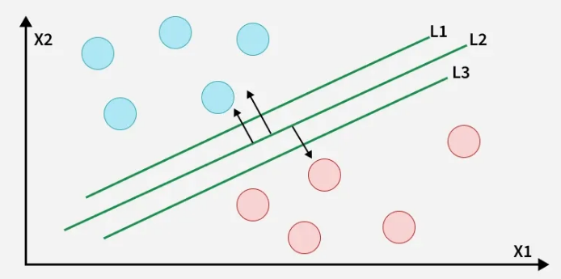
How does Support Vector Machine Algorithm Work?

Slide 9
Hard margin
The best hyperplane also known as the "hard margin" is the one that maximizes the distance between the hyperplane and the nearest data points from both classes. This ensures a clear separation between the classes.

Slide 10
How does SVM classify the data?
The blue ball in the boundary of red ones is an outlier of blue balls. The SVM algorithm has the characteristics to ignore the outlier and finds the best hyperplane that maximizes the margin. SVM is robust to outliers.

Slide 11
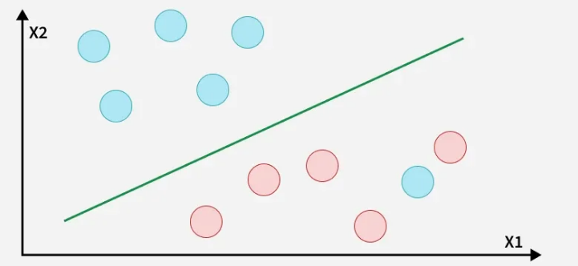
SVM is robust to outliers.
A soft margin allows for some misclassifications or violations of the margin to improve generalization.

Slide 12

Mathematical Computation of SVM
Consider a binary classification problem with two classes, labeled as +1 and -1. We have a training dataset consisting of input feature vectors X and their corresponding class labels Y. The equation for the linear hyperplane can be written as:
$w^{T}x+b=0$

Slide 13
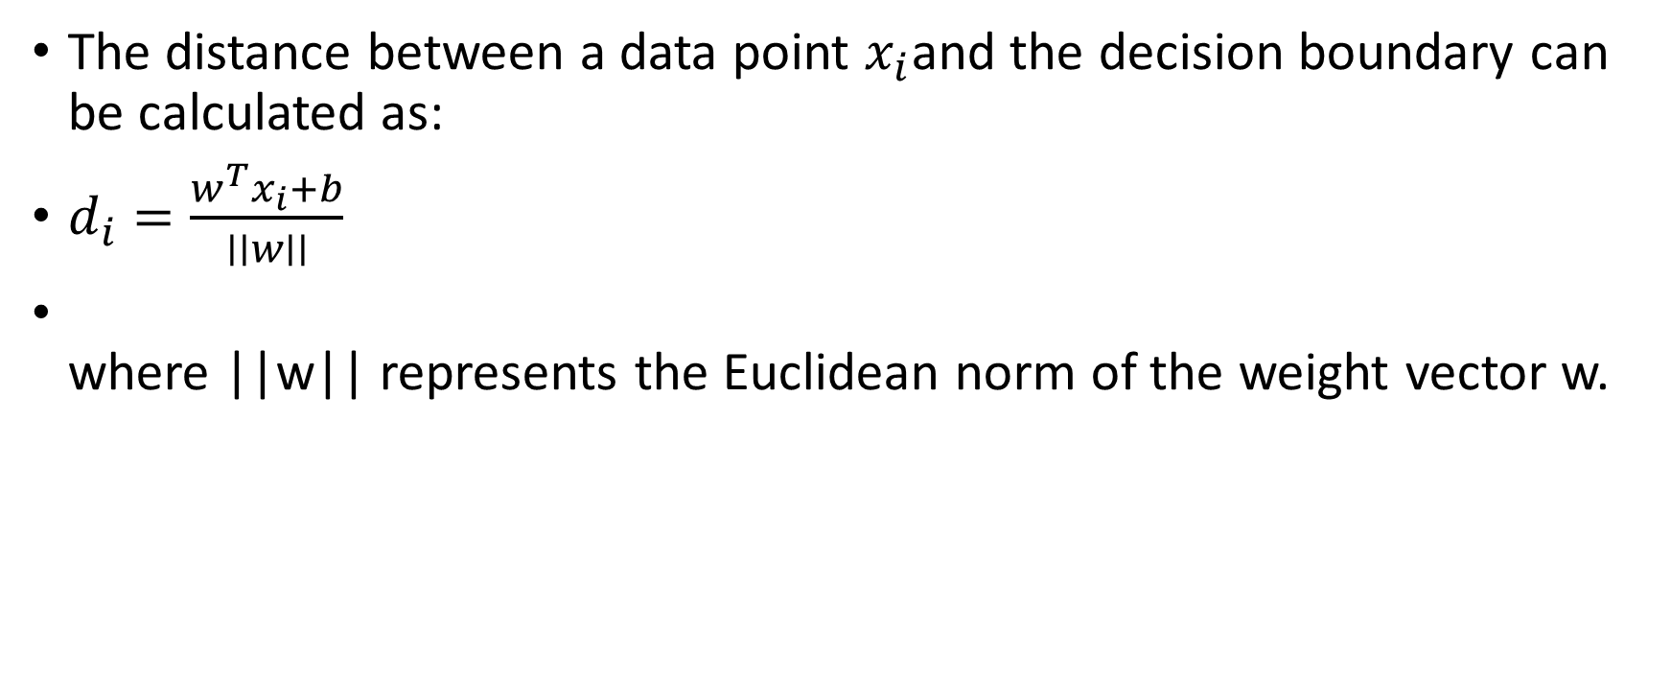
Distance from a Data Point to the Hyperplane
The distance between a data point $x_{i}$and the decision boundary can be calculated as:
$d_{i}=\frac{w^{T}x_{i}+b}{∣∣w∣∣}$
where ||w|| represents the Euclidean norm of the weight vector w.

Slide 14

Linear SVM Classifier
Distance from a Data Point to the Hyperplane:
$\hat{y}=\left\{\begin{matrix}1 & : w^{T}x+b≥0 \\ −1 & : w^{T}x+b <0\end{matrix}\right.$

Slide 15
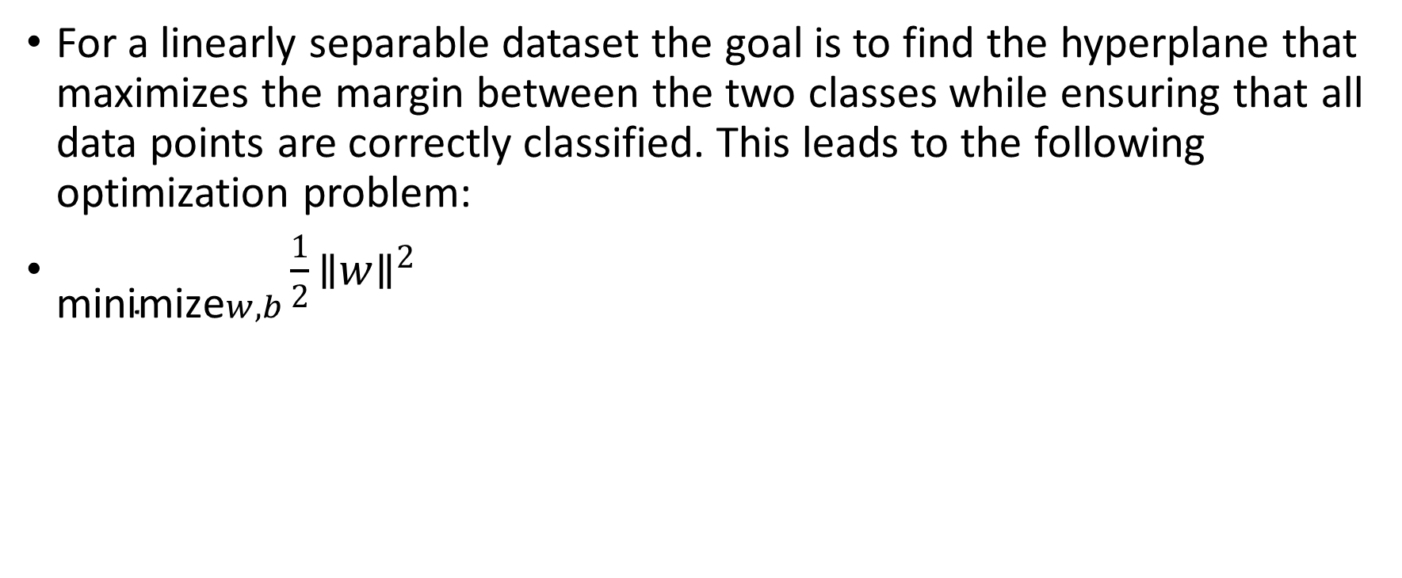
Optimization Problem for SVM
For a linearly separable dataset the goal is to find the hyperplane that maximizes the margin between the two classes while ensuring that all data points are correctly classified. This leads to the following optimization problem:
$\underset{\text{minimize}w,b}{}\frac{1}{2}{∥w∥}^{2}$

Slide 16
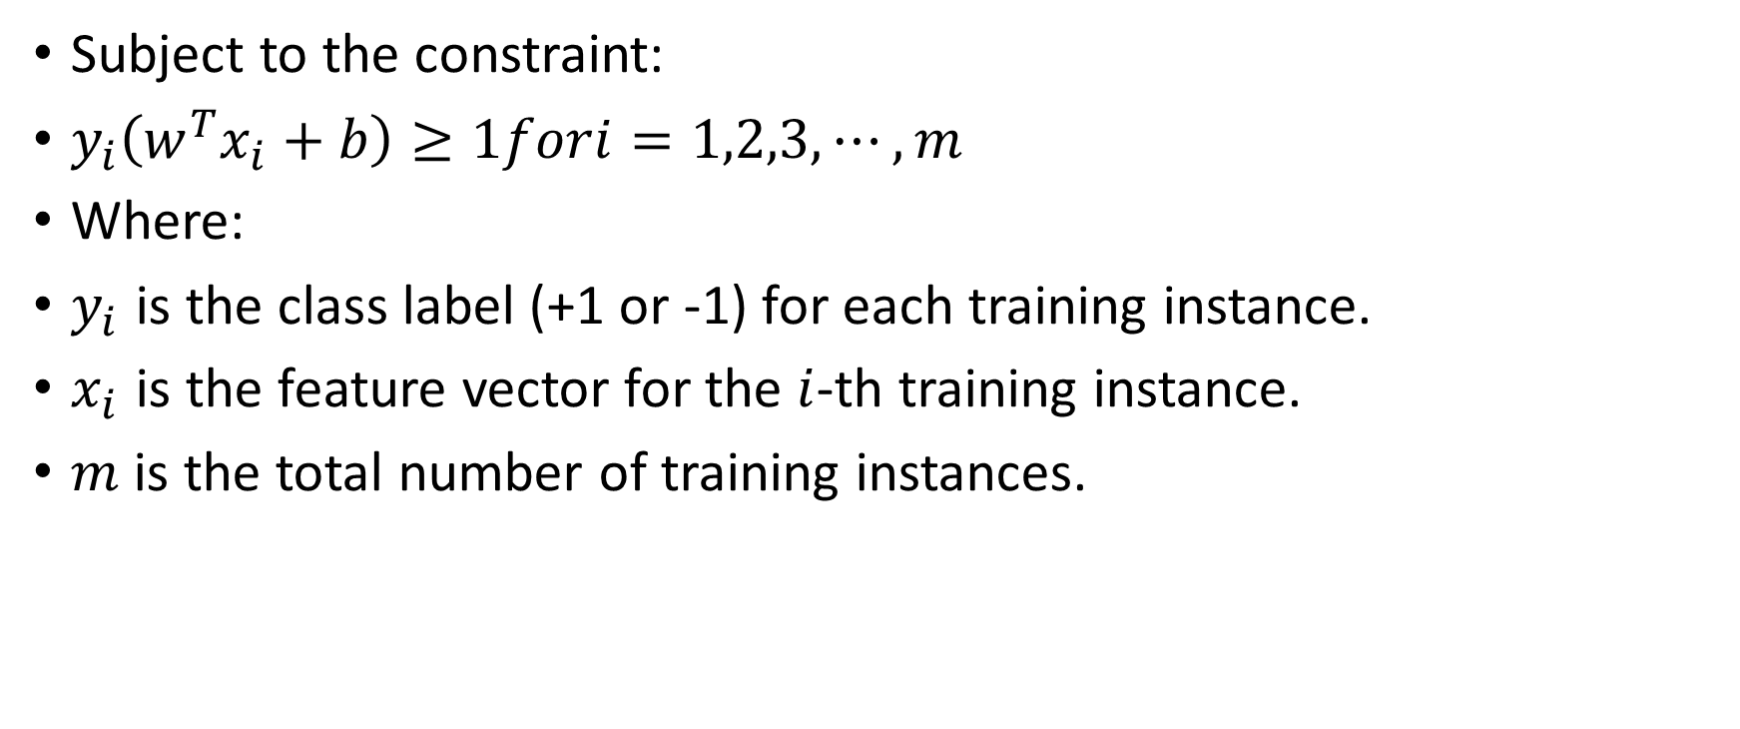
Optimization Problem for SVM
Subject to the constraint:
$y_{i}\left(w^{T}x_{i}+b\right)≥1fori=1,2,3,⋯,m$
Where:
$y_{i}$​ is the class label (+1 or -1) for each training instance.
$x_{i}$​ is the feature vector for the $i$-th training instance.
$m$ is the total number of training instances.

